Slide 1
Final Year Project: Week 13 of 20
Marij Qureshi 16th Jan 2020
Robust Optimisation of Composite Panels

Slide 2
Progress
Isight Automation – 1 week cut-off
Couldn’t get it to work – part of research
Main effort: Report synthesis and write-up – good progress
Reliable Design - completed
Robust + Reliable Design – completed
Now all structural design work completed, little more work on algorithm comparison needed

Slide 3
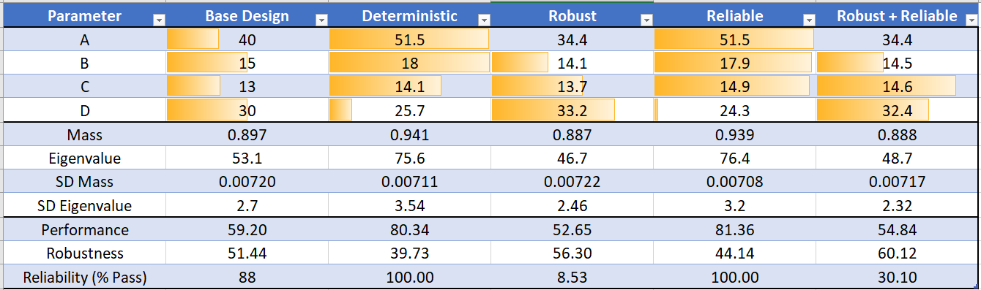
Optimal Design Comparison
Algorithm: NSGA2 (20 generations, 20 points per generation)
Slow, but most reliable for finding global optimum
Local optima at each side of design space

Slide 4
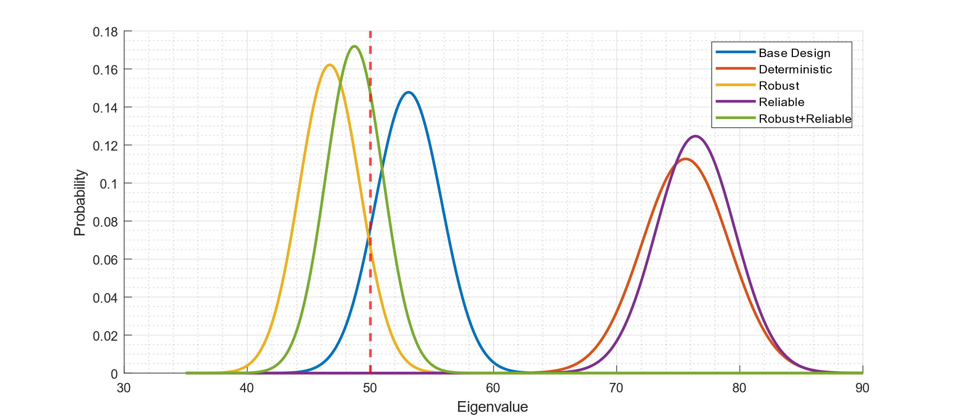
Optimal Design Comparison

Slide 5
Problems
Large variations in response
Fixed 1mm standard deviation geometry tolerances
What is realistic for composite manufacture?
Reducing this makes results look more like distinct peaks – deterministic always best
Would reducing design space help?
Hybrid design dominates robust
Reliable design dominates deterministic
Indicates optimisation weighting wrong

Slide 6
Optimisation Problems
Deterministic
Constraints:
Mass < Baseline
Buckle Load > Baseline
Objectives:
Minimise Mass
Maximise Buckle Load
Robust
Constraints:
Mass < Baseline
Buckle Load > Baseline
Objectives:
Minimise Mass
Maximise Buckle Load
Minimise SD Mass
Minimise SD Buckle Load
Reliable
Constraints:
Mass < Baseline
Buckle Load > Baseline
Failure < 0.1% ?
Objectives:
Minimise Mass
Maximise Buckle Load
Minimise Failure %
Robust + Reliable
Constraints:
Mass < Baseline
Buckle Load > Baseline
Objectives:
Minimise Mass
Maximise Buckle Load
Minimise SD Mass
Minimise SD Buckle Load
Minimise Failure %

Slide 7
Next steps
Exam week coming up – divert more attention there
Continue work on algorithm explanatory problems
Continue work on write-up

Slide 8
Progress
Case 1: Plate with hole
Case 2: Deterministic mono-string
Case 3: Robust mono-string
Main Objectives
Final Report Work
Workflow set-up and learning
Program efficiency + validation
Results validation + analysis
Auxiliary Objectives
Wks 17-19
Wks 1-3
Wks 4-9
Wks 10-15
Week | 1 | 2 | 3 | 4 | 5 | 6 | 7 | 8 | 9 | 10 | 11 | 12 | 13 | 14 | 15 | 16 | 17 | 18 | 19
Month | Jan |  | Feb |  |  |  | Mar |  |  |  |  | Apr |  |  |  | May

Slide 9
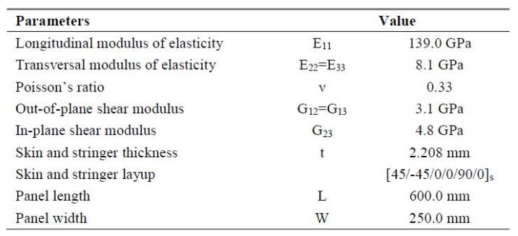
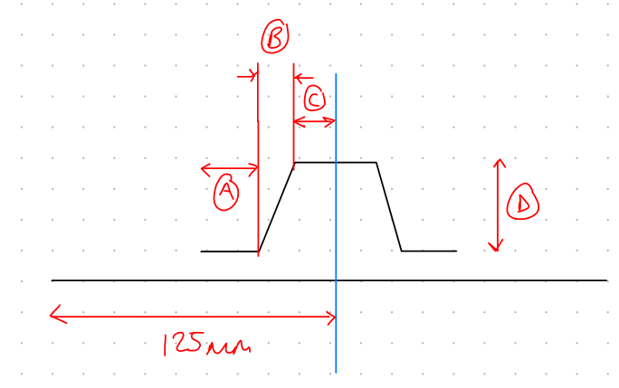
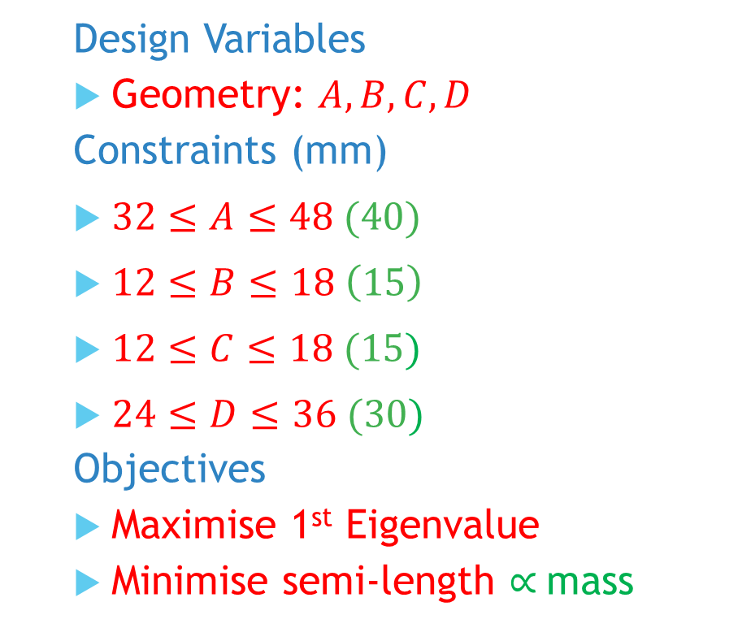
Mono-string: Problem
Design Variables
Geometry: $A,B,C,D$
Constraints (mm)
$32≤A≤48 (40)$
$12≤B≤18 \left(15\right)$
$12≤C≤18 (15)$
$24≤D≤36 (30)$
Objectives
Maximise 1st Eigenvalue
Minimise semi-length $∝$mass
Notes:
Post-buckling reliability design (vary lay-up)
Chapter 7: Robust Multilevel Design Optimization of Composite Panels
Robust and Reliability-Based Design Optimization of a Composite Floor Beam

